Slide 1
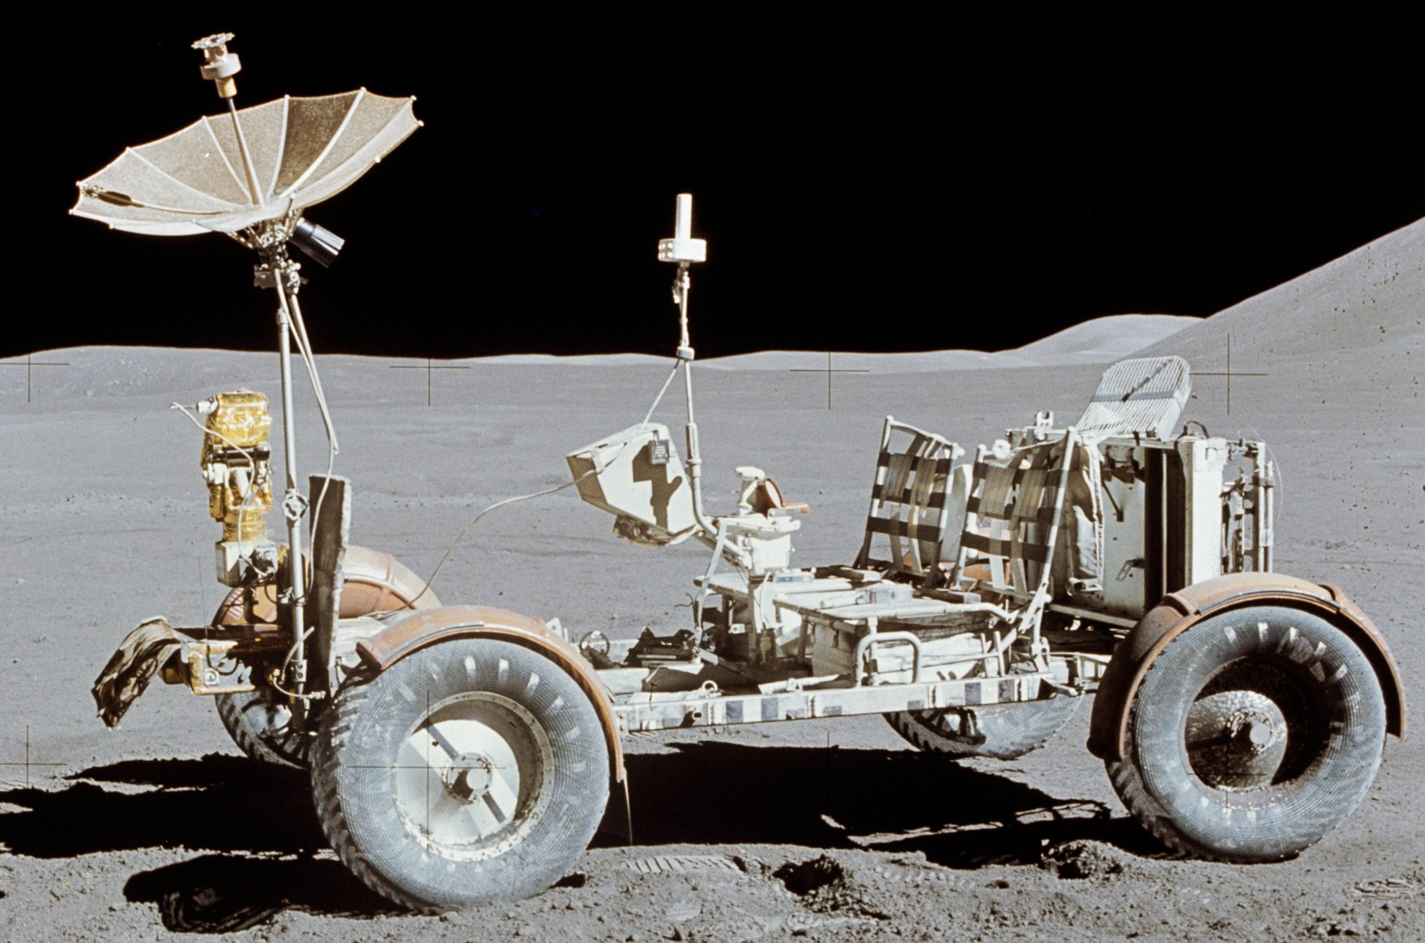
Robotics Drive Trains & Motors
Day 2 – Mission to Mars

Slide 2
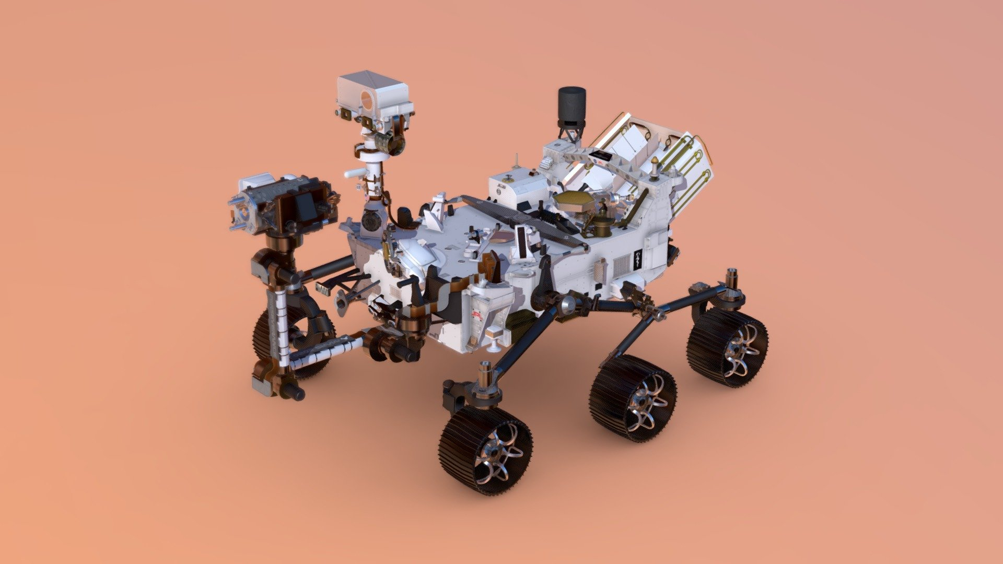
What is a drive train?
It is the mechanical system that allows a robot to move by transmitting power from the motors to the wheels.
It controls the robot’s motion — including speed, direction, and maneuverability.
Main Components:
Motors
Wheels
Gears / Gearboxes
Chassis / Frame
Notes:
Q: Why does the choice of drive train matter? The drive train affects how fast, powerful, and maneuverable the robot is. It plays a big role in:
How easily the robot can turn or strafe
How well it handles obstacles or ramps
How much control you have during precise movements
Battery efficiency and match performance
Q: What are some things to consider when choosing a drive train?
Mobility: Can it move in all directions or just forward/back?
Turning radius: Does it need to rotate in place?
Field challenges: Are there obstacles or terrain features?
Complexity: Is it easy to build and program?
Power needs: Will it strain the battery or motors?

Slide 3

Why Does the Choice of Drive Train Matter?
Impact Areas:
Speed: How fast the robot can move across the field
Traction: Ability to grip the surface (important for ramps, pushing)
Agility: How easily the robot can turn, strafe, or reposition
Control: Precision in movement (critical for autonomous modes)
Energy Efficiency: How much battery power it uses during a match
In Competition: A poorly chosen drive train can limit what your robot can do, no matter how good the other systems are!

Slide 4

Choosing a Drive Train
Mobility Type:
Simple forward/backward? Omnidirectional (strafe, rotate in place)?
Field Obstacles:
Are there barriers, ramps, rough terrain?
Build & Programming Complexity:
Are you ready to handle more advanced construction and programming?
Weight and Power:
Heavier robots need more torque and stronger drive trains

Slide 5
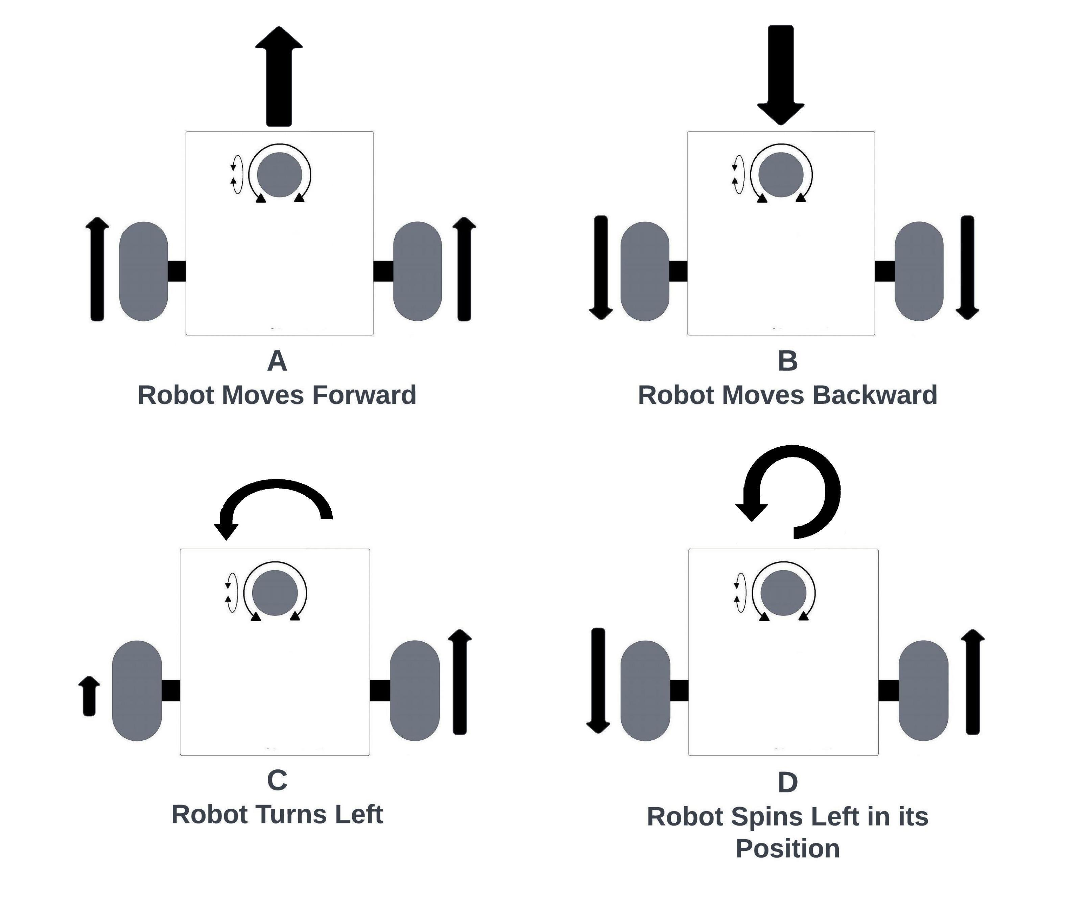
How Does Differential Drive Move?
Both wheels spin forward at the same speed.
Both wheels spin backward at the same speed.

Slide 6
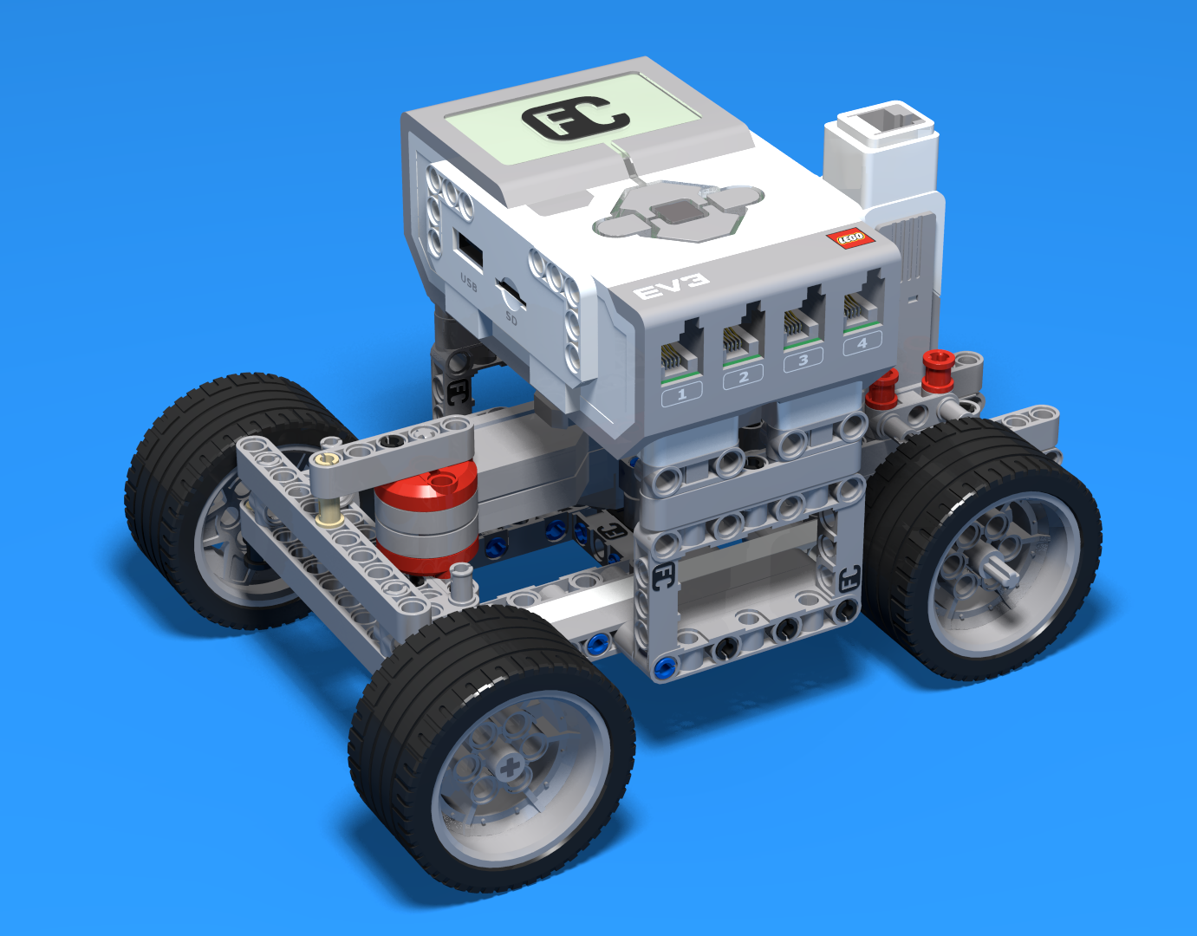
Differential Drive
A drive system where two wheels are independently powered by separate motors. The robot turns by spinning the wheels at different speeds.
Typical Layout:
Two powered wheels (left and right)
One or two passive casters (small free-rolling wheels) for balance
Simple but Powerful:
Easy to build
Easy to program
Very reliable

Slide 7
How Does Differential Drive Move?
Right wheel spins faster or moves while left wheel slows/stops.
Right wheel forward, left wheel backward = rotate counterclockwise

Slide 8
Pros and Cons of Differential Drive
Pros:
Very simple to build and program
Great for driving in straight lines
Strong pushing power (good for defense tasks)
Highly reliable — fewer parts to fail
Cons:
Cannot strafe (no side-to-side movement)
Turning radius can be wide unless wheels rotate in opposite directions
Drag from passive casters can cause slight inaccuracies in autonomous movement

Slide 9
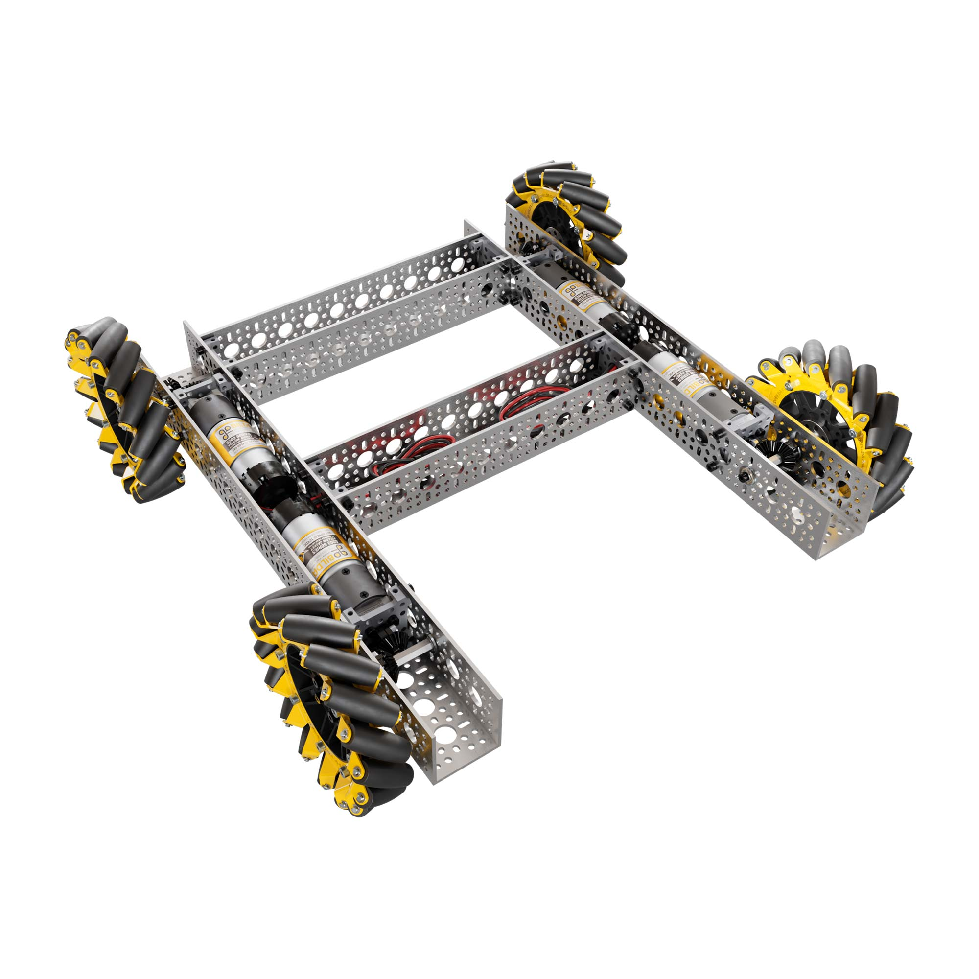
Mecanum Drive Train
A Mecanum drive uses special wheels with angled rollers, allowing the robot to move in any direction — forward, backward, sideways (strafe), and diagonally — without changing its orientation.
Key Feature: The angled rollers on the wheels (usually 45°) create forces that combine to move the robot in complex ways.
Typical Layout: 4 Mecanum wheels, one on each corner of the robot.

Slide 10
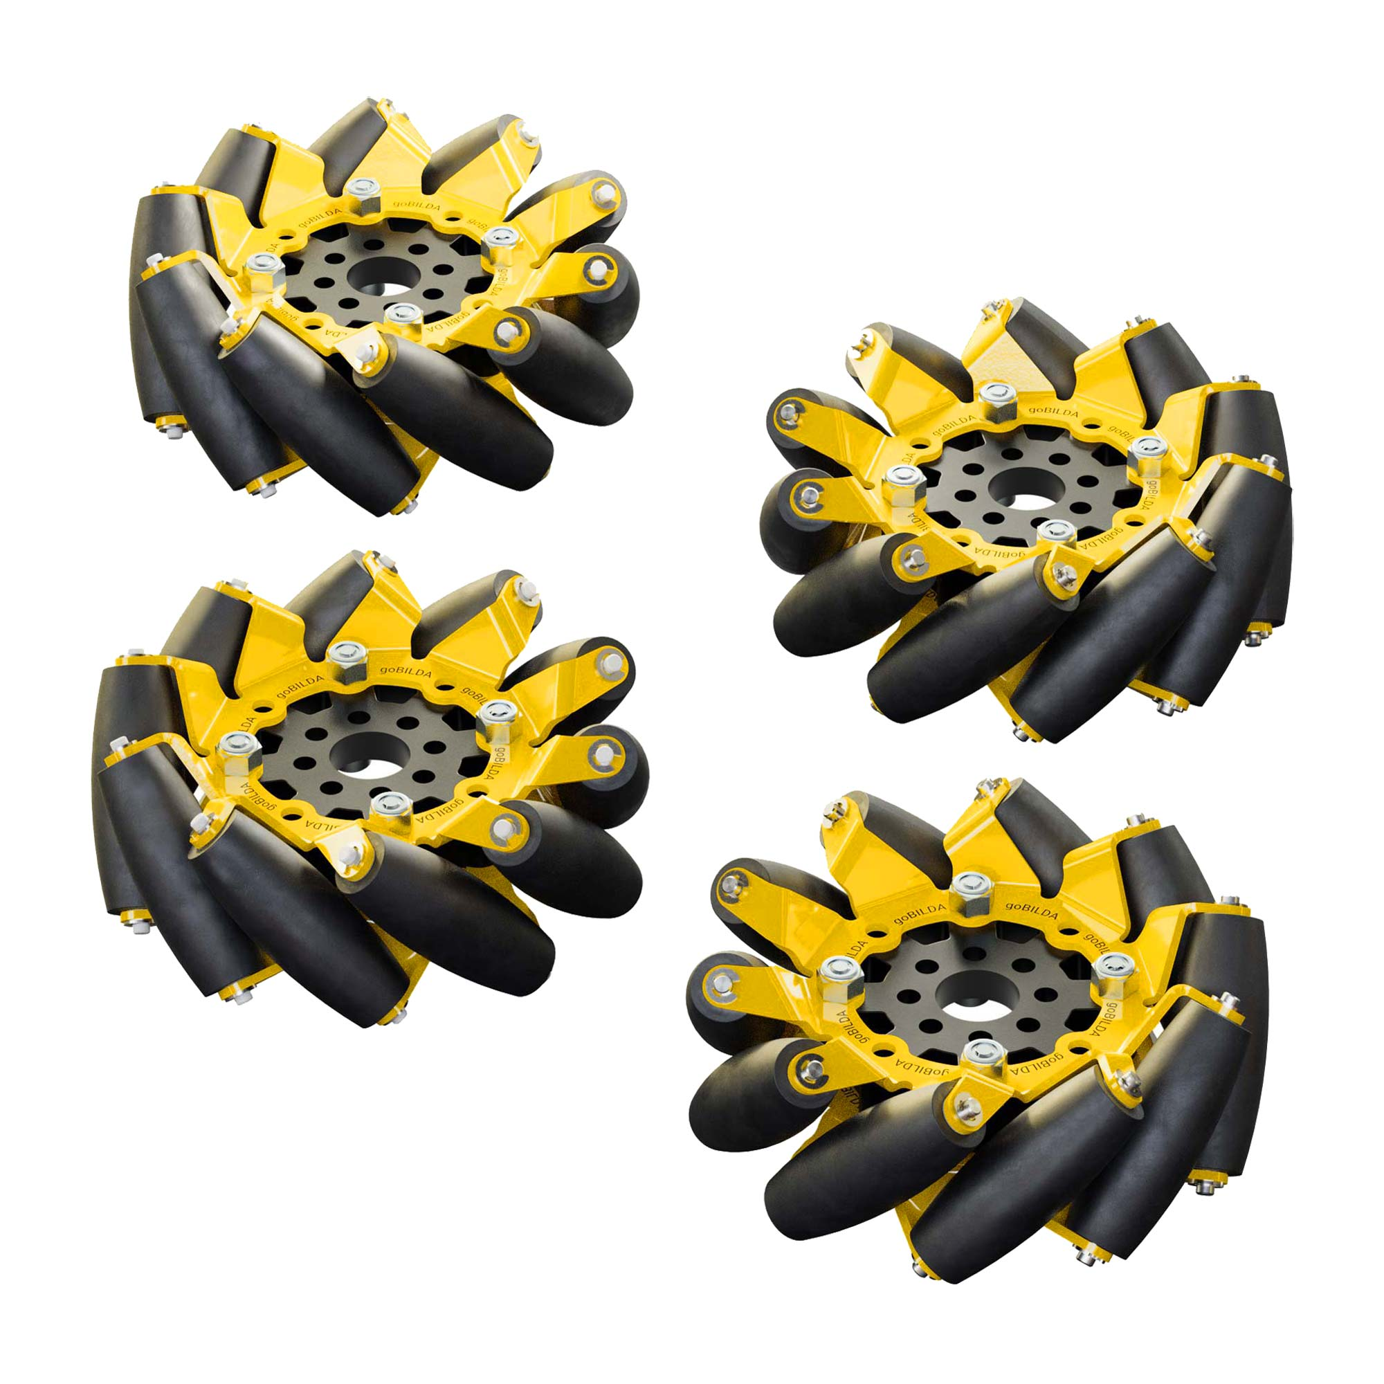
Mecanum Rollers

Slide 11
How Mecanum Wheels Work
Each Wheel Pushes at an Angle:
Front-left and back-right wheels are mirrored.
Front-right and back-left wheels are mirrored.
Movement Control:
Combining wheel speeds and directions controls overall motion.
The robot's movement is the vector sum of forces from all four wheels.

Slide 12
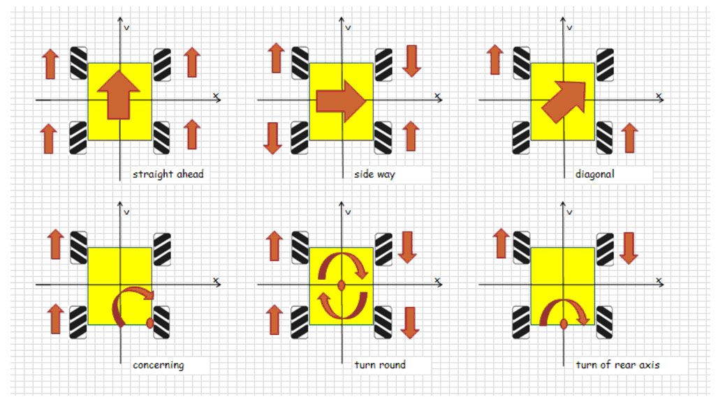
Motion Types with Mecanum Drive
Roboteq.com

Slide 13
Motion Types with Mecanum Drive
Roboteq.com

Slide 14
Motion Types with Mecanum Drive
Motion | Wheel Behavior
Forward | All wheels spin forward equally
Backward | All wheels spin backward equally
Strafe Right | Left wheels spin forward, right wheels spin backward
Strafe Left | Left wheels spin backward, right wheels spin forward
Rotate Clockwise | Front-left and back-left wheels spin backward, front-right and back-right spin forward
Diagonal Movement | Different combinations of wheels spinning faster/slower

Slide 15
Pros and Cons of Mecanum Drive
Advantages:
Full 360° movement — extremely maneuverable.
Can move sideways without turning.
Powerful for complex strategies (positioning, dodging, collecting).
Challenges:
Requires precise motor control and tuning.
Slight loss of force efficiency compared to traction wheels.
Programming is more complex (requires vector math).
Wheels are more expensive and delicate.

Slide 16
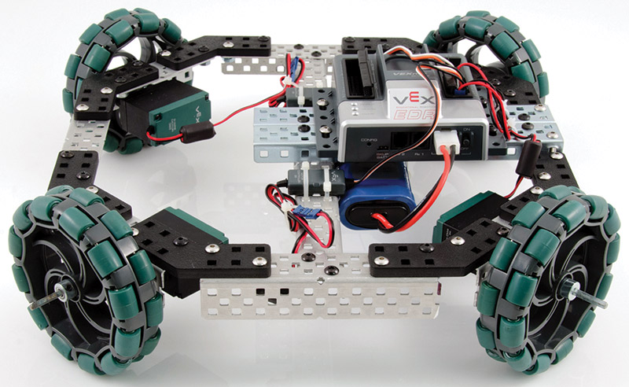
X-Drive
An X-Drive uses omni wheels mounted at 45° angles to allow full omnidirectional movement.
Key Feature: Wheels directly face the robot’s movement directions — no angled rollers like Mecanum; the wheels themselves slide easily.
Typical Layout: 4 omni wheels placed in an "X" formation when viewed from above.

Slide 17
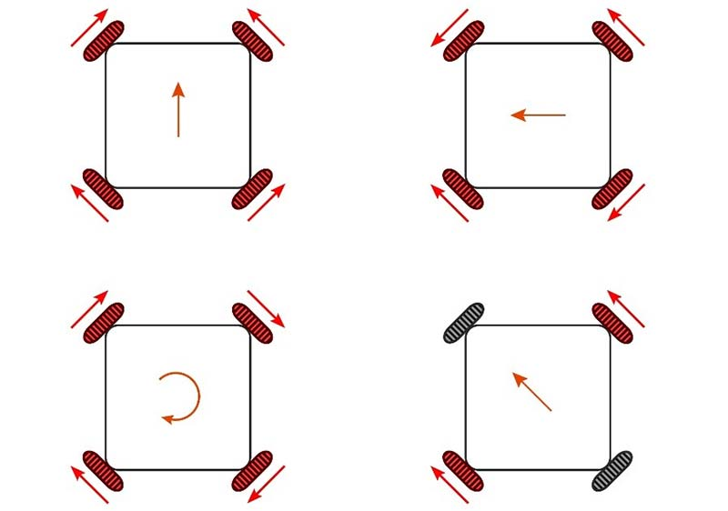
X-Drive movement

Slide 18
Pros and Cons of X-Drive
Pros:
True omnidirectional motion
Lighter and simpler mechanical build compared to Mecanum
Easier math for programming (FTCLib or basic trig)
Cons:
Lower pushing force (torque spread across angles)
Frame must be rigid — any flex affects movement accuracy
Not ideal for heavy robots

Slide 19
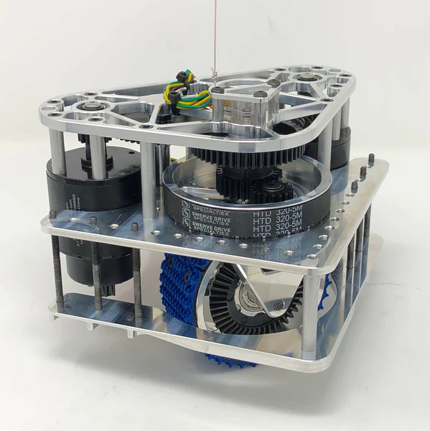
Swerve Drive Trains
Swerve drive uses independent drive and steering for each wheel
Allows full omnidirectional movement and precise control
Each wheel module:
Rotates (steers) 360°
Drives forward/backward independently
Pros:
Ultimate maneuverability
Smooth diagonal motion and rotation in place
Cons:
Mechanically and programmatically complex
Heavy and expensive

Slide 20
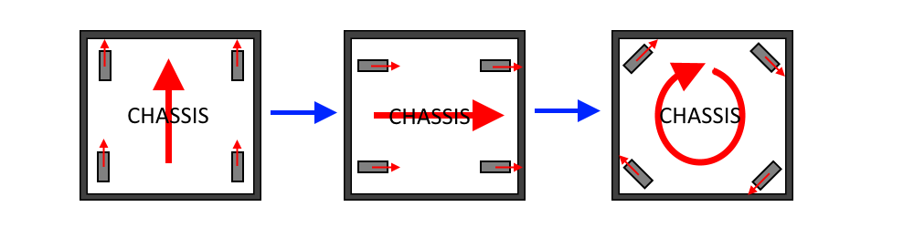
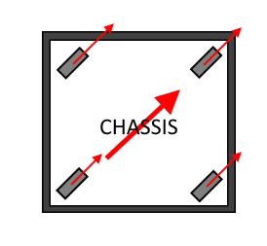
Swerve Drive Movement
Team 6624’s SW Guide

Slide 21
Mars Rover Drive Systems
Rover | Wheels | Drive | Steering
Sojourner | 6 | Differential | No steering motors
Spirit | 6 | Independent | Front and rear steering
Opportunity | 6 | Independent | Front and rear steering
Curiosity | 6 | Independent | Front and rear steering
Perseverance | 6 | Independent | Front and rear steering (improved)
Zhurong | 6 | Independent | Front and rear steering
Notes:
Drive System Details:
Independent Drive Motors: Each wheel has its own motor, allowing the rover to drive even if one wheel fails.
Steering Motors:
Spirit, Opportunity, Curiosity, Perseverance: Front and rear wheels have independent steering motors.
Perseverance: Has even more advanced wheel steering to reduce wheel wear and enable "crab walking" (moving diagonally).
Suspension System: All major Mars rovers use rocker-bogie suspension for stability on extremely rough terrain — it allows rovers to climb over rocks almost as tall as their wheels without tipping over.
Turning Type:
Skid Steering (Sojourner) — turns by spinning wheels at different speeds (like a tank).
Combined Steering (others) — steered wheels + independent drive for sharper, smoother turns.

Slide 22
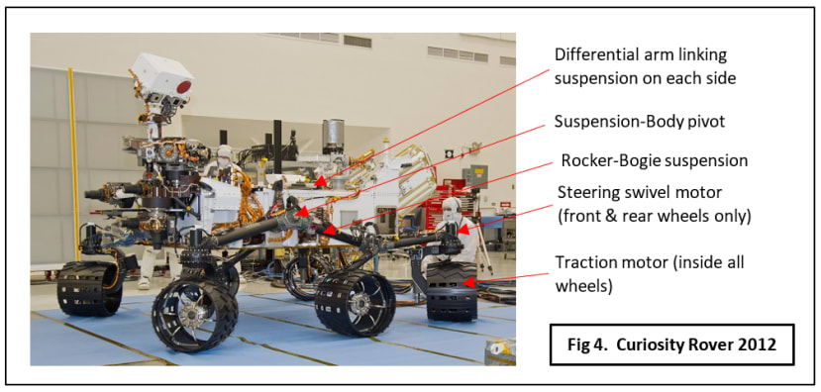
Curiosity Rover

Slide 23
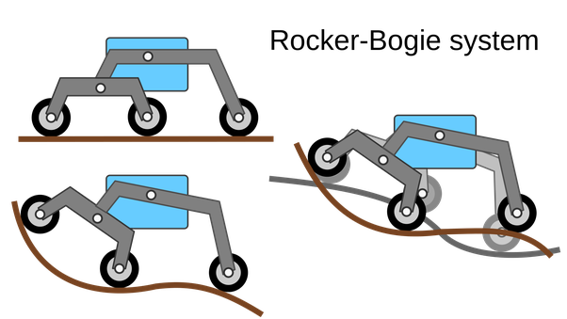
Rocker-Bogie Suspension
Rocker-bogie is a special suspension system that lets a rover keep all six wheels on the ground — even when climbing over big rocks or driving on uneven surfaces.
How It Works:
Rocker: Each side of the rover has a “rocker” arm that can pivot up and down independently.
Bogie: Each rocker connects to a "bogie" — a smaller pivoted beam that holds two wheels.
Balance: When one wheel climbs over an obstacle, the rocker and bogie flex to keep the rover stable and spread out the weight.

Slide 24
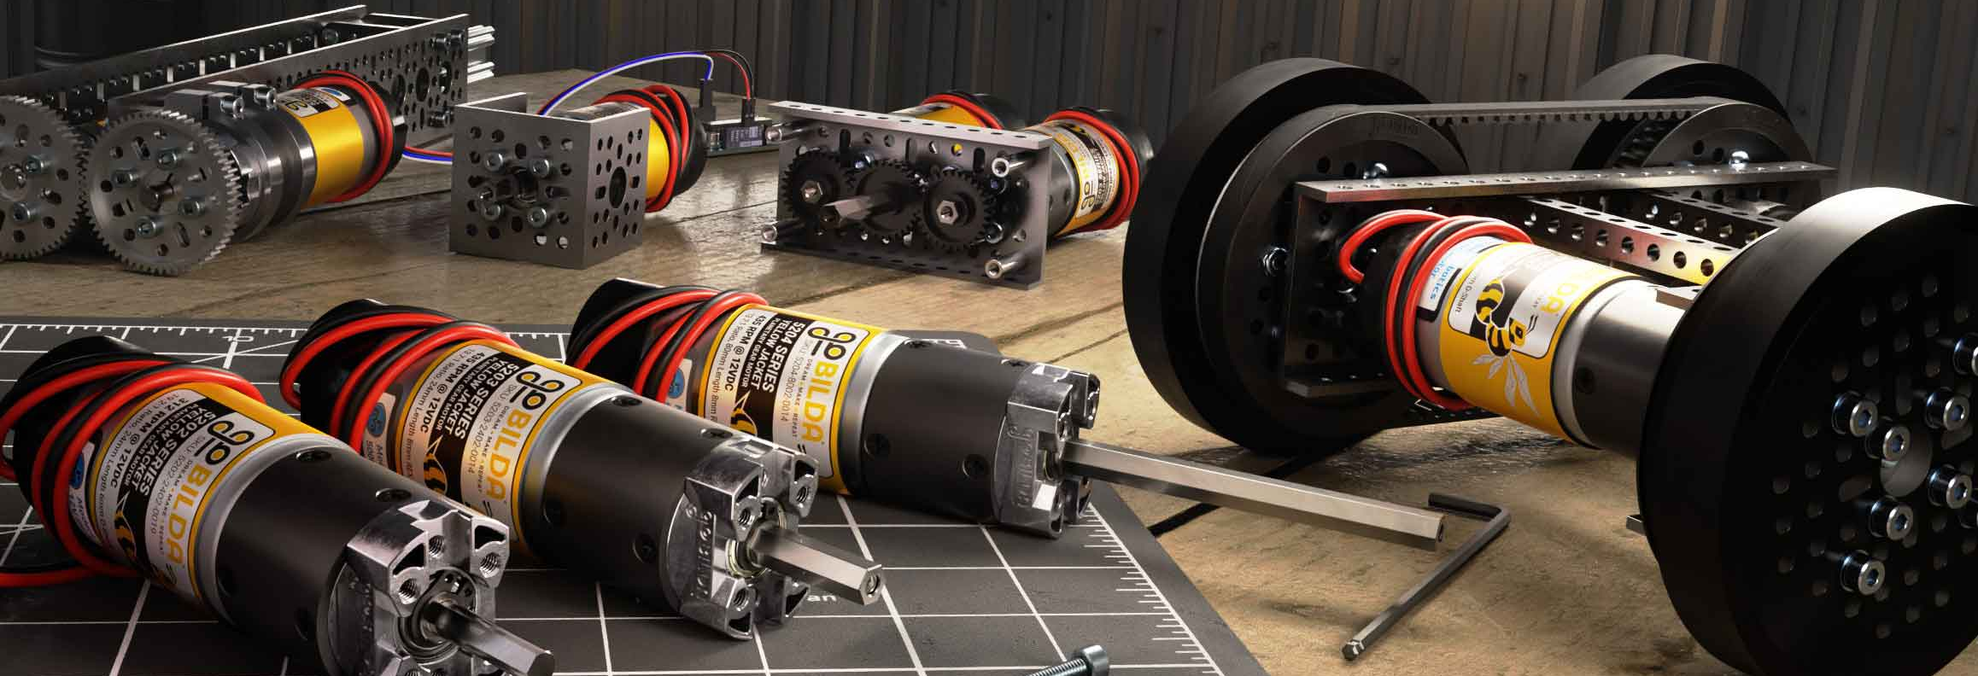
Motors in Robotics
Powering Your Rover

Slide 25
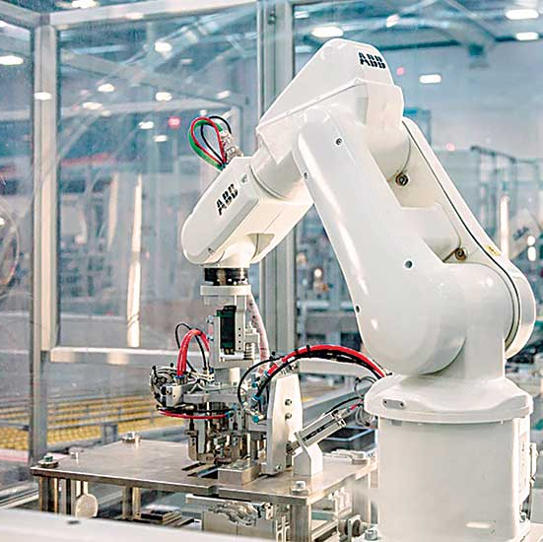
Why Motors Matter
Motors are the muscles of a robot
Convert electrical energy → mechanical motion
Essential for drive trains, arms, lifts, and more

Slide 26
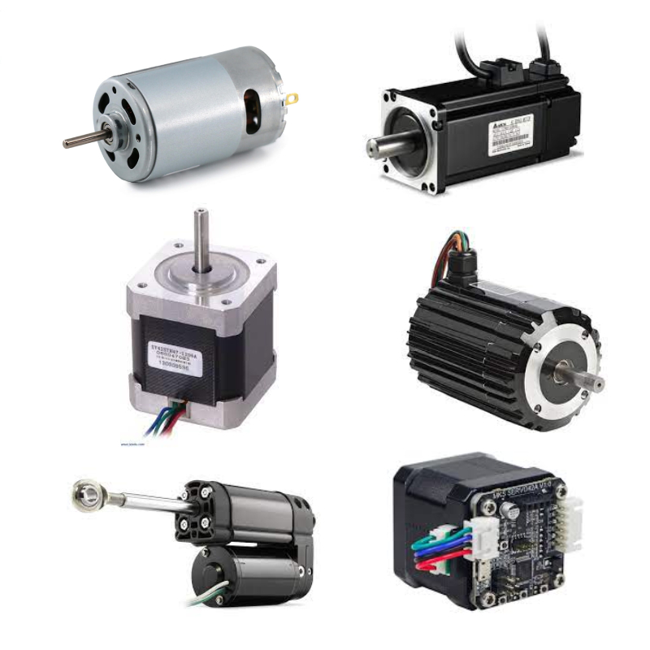
Types of Motors in Robotics
DC Motors: Continuous rotation, ideal for driving and lifting
Servo Motors: Limited range of motion, good for precise control
Stepper Motors: Precise, step-by-step rotation

Slide 27
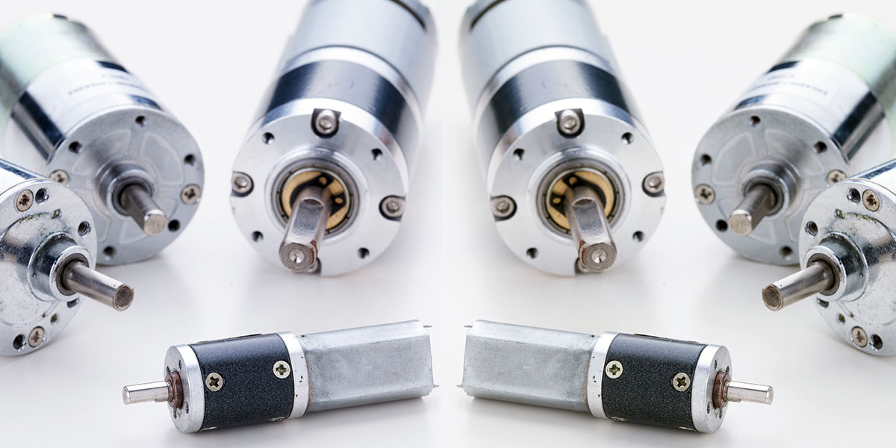
DC Motors
Most common motor type in robotics
Spin continuously in either direction
Speed and torque depend on voltage and gear ratio
Often paired with encoders for feedback

Slide 28
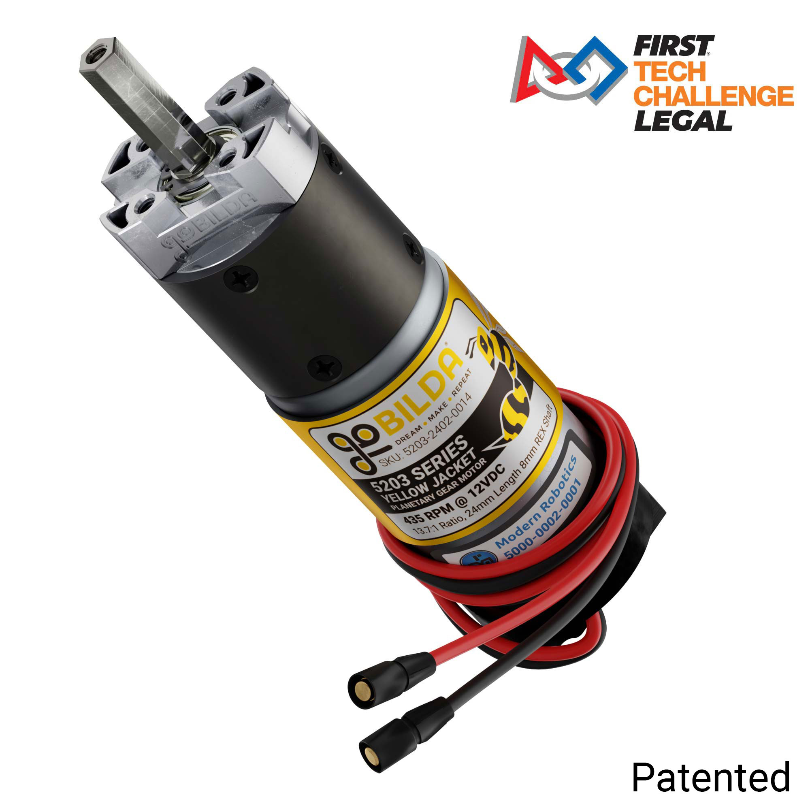
GoBilda 5-Series Motors
Planetary gear motors with high reliability
5mm D-shaft, compact and modular
Compatible with FTC-standard building systems
We’ll be using the 312 RPM, 19.2:1 ratio motors in our drive trains

Slide 29
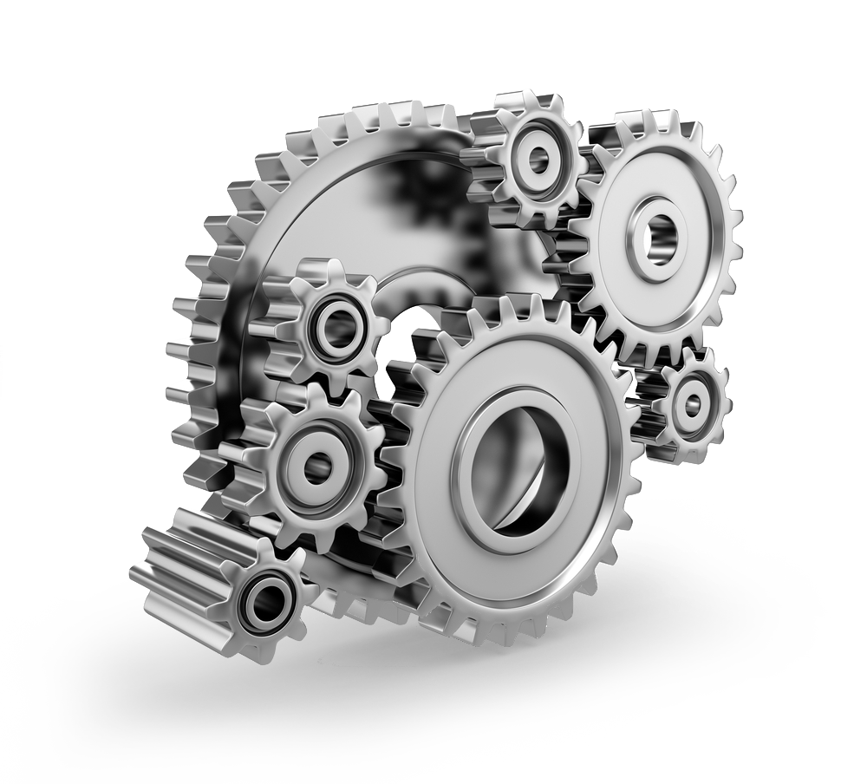
Gear Ratios
Tells how many times the motor spins for one full turn of the output shaft
High gear ratio = more torque, less speed
Low gear ratio = more speed, less torque
Choose based on function:
Drive train = moderate speed/torque
Arm/lift = high torque
Our motor’s ratio is 19.2:1 - the motor spins 19.2 times for the output shaft to spin once

Slide 30

Motor Direction and Power Basics
Motor power is set from -1 to 1:
1 = full speed forward
-1 = full speed in reverse
0 = stop
Used to control speed and direction of movement
Default stop behavior at 0 power:
Motors brake (resist movement)
Can be changed to float if free movement is needed

Slide 31
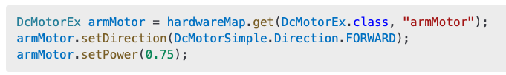
Programming a Motor
This sets the motor named "armMotor" to spin forward at 75% power
You can set power anywhere between -1 and 1
Use the setDirection method to REVERSE if needed.
Always match hardware names in code to those configured in the Control Hub
Notes:
DcMotorEx leftMotor = hardwareMap.get(DcMotorEx.class, "armMotor");
leftMotor.setDirection(DcMotorSimple.Direction.FORWARD);
leftMotor.setPower(0.75);

Slide 32
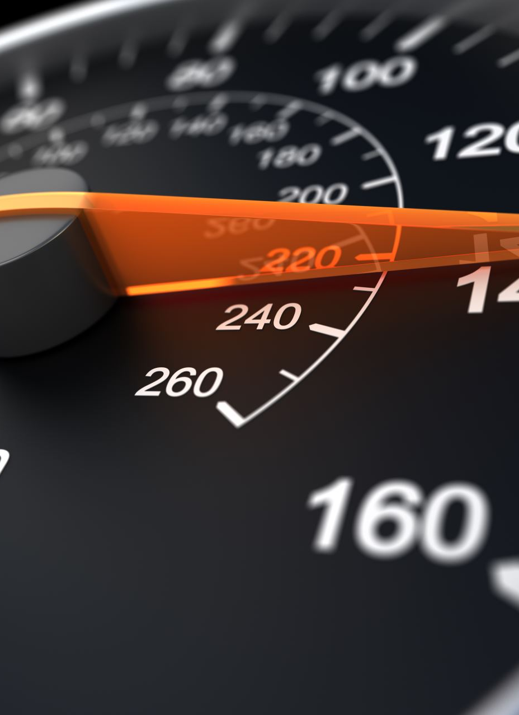
Motor Encoders
Motor Encoder is a sensor inside the motor that tracks how much it has rotated.
Reports motion in "ticks" or "counts"
Integrated encoders allow for:
Precise speed control & position tracking
Closed-loop feedback with PID
Software libraries provide motor control features
The 312 RPM motor has 537.6 ticks per shaft revolution
Notes:
🌀 What is an Encoder?
A sensor inside the motor that tracks how much it has rotated
Reports motion in "ticks" or "counts”
🔧 GoBilda 312 RPM Motor Specs:
Integrated encoder resolution: 28 counts per motor revolution
With a 19.2:1 gear ratio, this becomes:
28 × 19.2 = 537.6 ticks per output shaft revolution
📏 What does that mean?
If your wheel is directly attached to the output shaft:
1 full wheel rotation = ~538 encoder ticks
Want to drive the robot forward 1 wheel rotation?
Set a target position of 538 ticks
🧠 Why it’s useful:
Measure how far the robot moves
Stop at precise locations (like lines or junctions)
Run motors to specific positions or hold them still
💡 In Code (FTCLib style):
motor.setTargetPosition(538); // one rotation
motor.setMode(RunMode.PositionControl);
motor.set(0.5); // move at 50% power

Slide 33

Week #1 Goal
Build & code a Differential drive rover
Build & code a Mecanum drive rover
Compare performance

